Slide 1
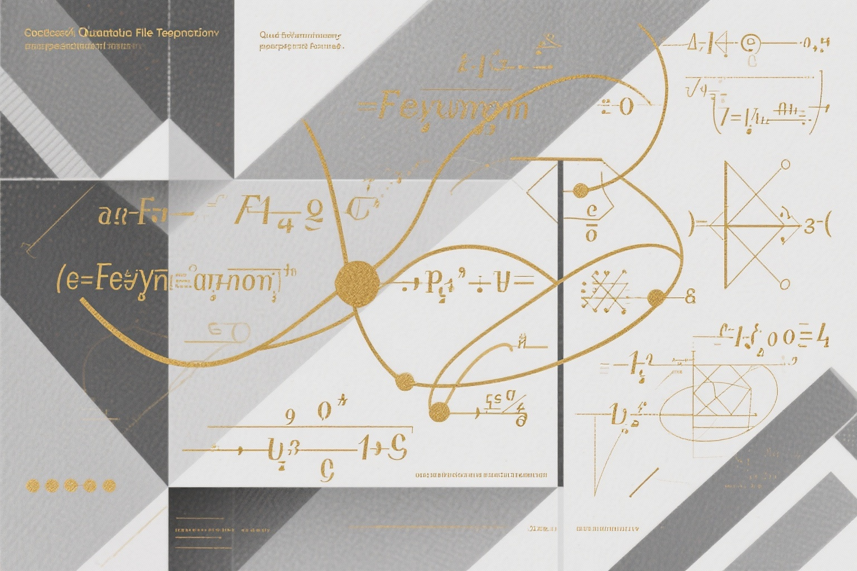
SOVIET
QUANTUM FIELD THEORY
The Hidden Genius of Cold War Physics
CLASSIFIED KNOWLEDGE • SCIENTIFIC REVOLUTION • HISTORICAL REVELATION

Slide 2
CONTENTS
Vladimir Fock: The Philosopher-Physicist
Vitaly Ginzburg: From Hydrogen Bomb to Nobel Prize
01
04
02
Lev Landau: The Universal Genius
05
The Quantum Field Theory Revolution
03
The Classified Realm: Arzamas-16
06
Legacy and Historical Significance
A journey through the classified scientific achievements that shaped modern physics

Slide 3
THE GOLDEN AGE
of Soviet Physics

Slide 4
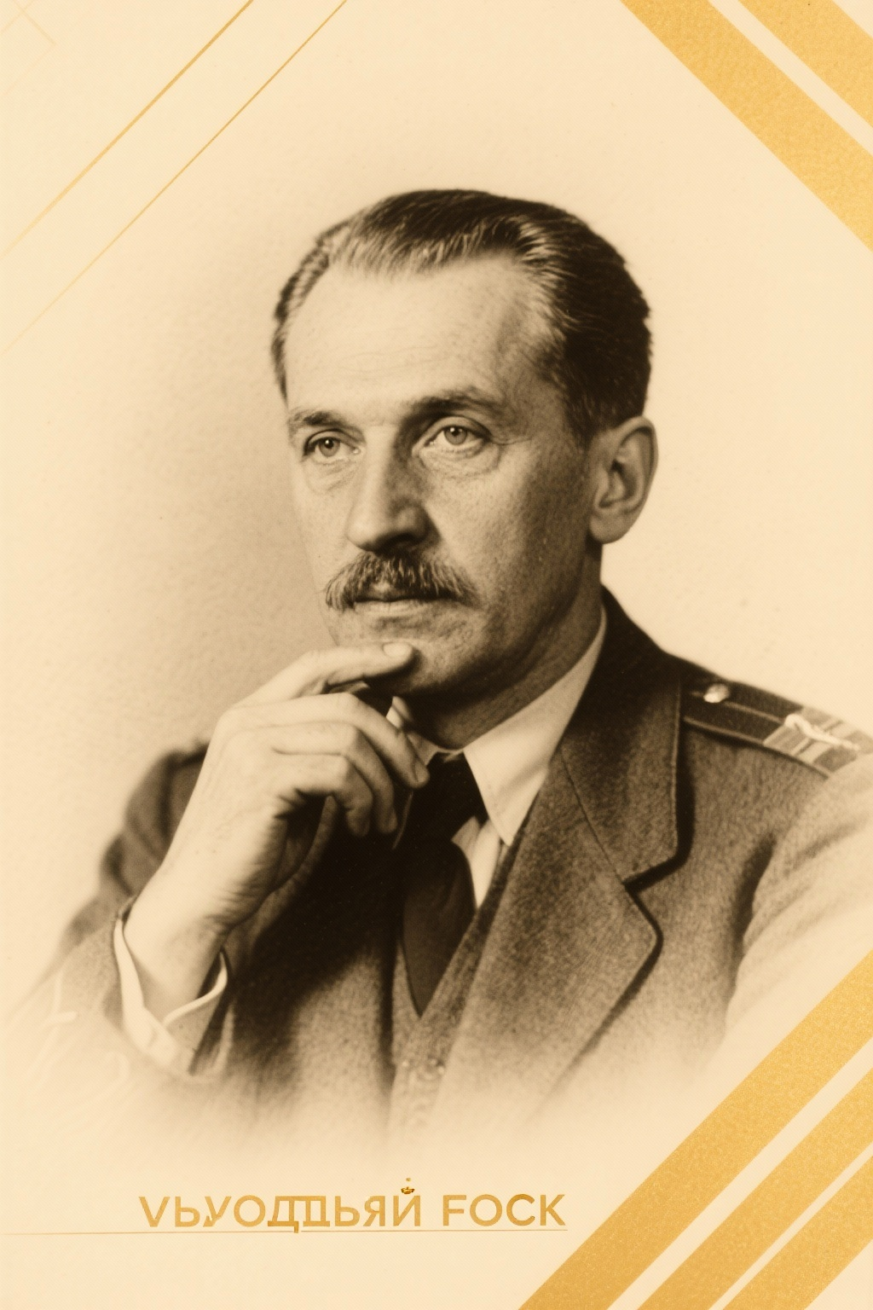
VLADIMIR FOCK
The Philosopher-Physicist
Vladimir Aleksandrovich Fock (1898-1974) was a foundational figure in Soviet quantum mechanics and quantum electrodynamics, renowned for reconciling modern physics with Marxist philosophy.
His 1957 visit to Copenhagen sparked a famous dispute with Niels Bohr over quantum interpretation. Fock later claimed convergence with Bohr's ideas, particularly on the reality of the world independent of human observation.
Beyond ideology, Fock's epistemology relied on antireductionism and scientific realism , developing interpretations that sought to transcend Bohr's approach through field quantization and second quantization methods.
1898-1974
1957
Lifespan
Copenhagen Visit

Slide 5
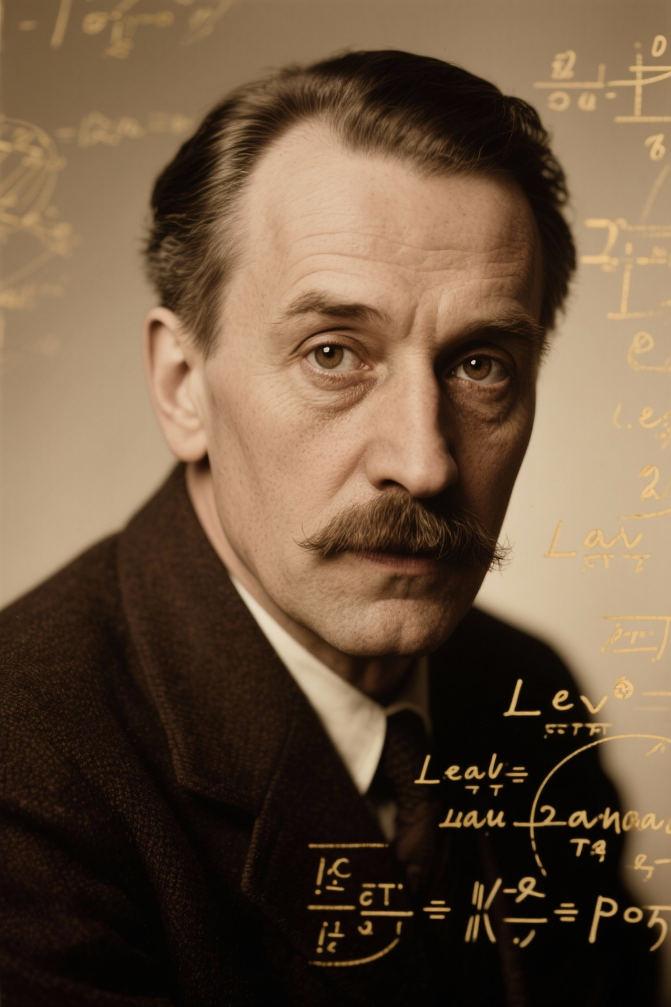
LEV LANDAU
The Universal Genius
Lev Davidovich Landau (1908-1968) created the most influential theoretical physics school in Soviet history. A graduate of Leningrad University at 19, he later studied under Niels Bohr.
His work spanned quantum mechanics, nuclear physics, QED, low-temperature physics, and fluid mechanics, including the theory of superfluidity in liquid helium and Fermi liquid theory.
Despite facing arrest in 1938 on espionage charges, he survived and continued his groundbreaking work, earning the Nobel Prize in 1962 for his theories of condensed matter.
1908-1968
1962
Lifespan
Nobel Prize

Slide 6

ARZAMAS-16
The Classified Realm
Established in 1946 at the former Sarov Monastery, Arzamas-16 was the Soviet Union's premier nuclear weapons R&D center, officially the All-Russian Scientific Research Institute of Experimental Physics (VNIIEF).
This secret city, removed from all maps until 1994, housed Design Bureau No. 11 (KB-11) where the first Soviet atomic bomb was developed under scientific director Yulii Khariton and Igor Kurchatov.
The facility developed the RDS-1 atomic bomb (1949) , the RDS-6S hydrogen bomb (1953), and the AN602 'Tsar Bomba'—the most powerful nuclear device ever detonated.
1946
1994
20,000
Established
Declassified
Scientists

Slide 7
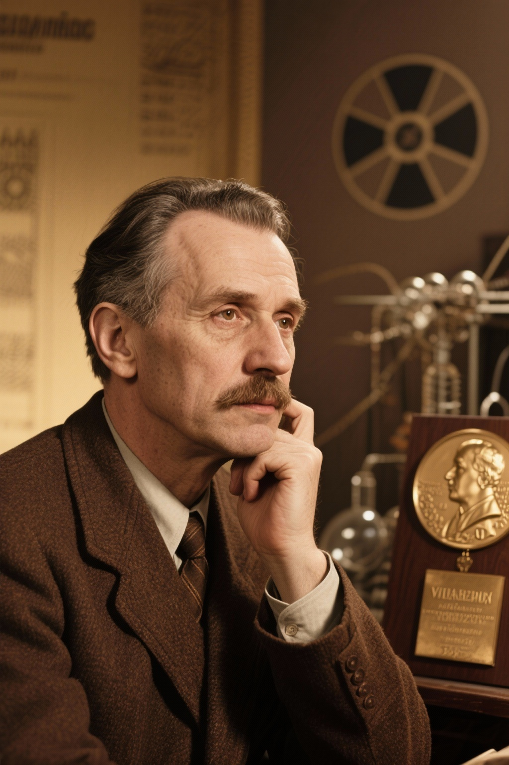
VITALY GINZBURG
From Hydrogen Bomb to Nobel Prize
Vitaly Lazarevich Ginzburg (1916-2009) exemplified the duality of Soviet physics. Working on the hydrogen bomb project from 1948-1952, he suggested using lithium-6 deuteride as fuel, crucial for the bomb's success.
Despite persecution during Stalin's anti-Semitic campaigns, his nuclear work offered protection. His most enduring contribution was the Ginzburg-Landau theory of superconductivity , developed in the 1950s.
This work earned him the 2003 Nobel Prize in Physics, demonstrating how classified research could yield fundamental scientific breakthroughs decades later.
1948-52
2003
H-Bomb Project
Nobel Prize

Slide 8
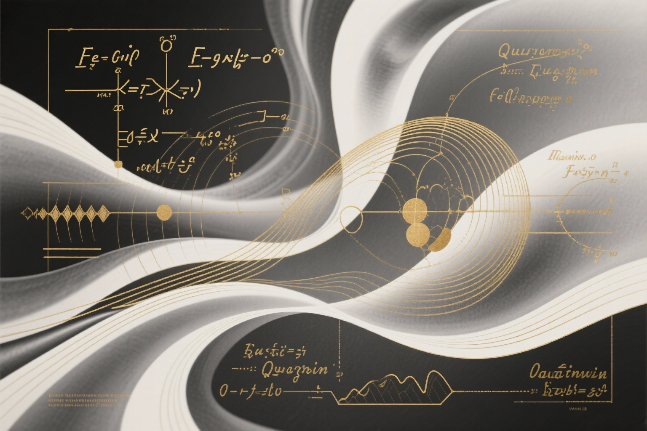
THE QUANTUM FIELD THEORY REVOLUTION
Soviet physicists made fundamental contributions to quantum field theory in the 1950s, when the field faced significant mathematical challenges.
Landau and Nikolai Bogolyubov developed innovative mathematical approaches that rivaled American contributions by Schwinger and Dyson, excelling in dispersion relations and second quantization methods.
The Tamm-Dancoff scheme and Fock's field quantization were major advances. Soviet textbooks on QFT became standard references worldwide, often translated and used in American universities.
Dispersion Relations
Field Quantization
Tamm-Dancoff
Global Impact
Bogolyubov's rigorous proof
Fock's developments
Scheme development
Textbooks worldwide

Slide 9
LEGACY
The legacy of Soviet quantum field theory reveals how scientific genius flourished even under challenging political conditions. From Fock's philosophical insights to Landau's universal contributions, from the secret laboratories of Arzamas-16 to Nobel Prize-winning work, Soviet physics demonstrated remarkable creativity and rigor.
The declassification of these works has revealed not just technical achievements, but a deeper story of human intellect persevering through ideological constraints to advance our understanding of the quantum world.
SCIENTIFIC EXCELLENCE • CLASSIFIED KNOWLEDGE • HISTORICAL REVELATION

